Slide 1
Electronic Devices
Final Term Lecture - 01
Reference book:
Electronic Devices and Circuit Theory (Chapter-5)
Robert L. Boylestad and L. Nashelsky , (11th Edition)

Slide 2
OBJECTIVES
Become familiar with there, r_{e}, hybrid and hybrid pi models for the BJT transistor.
Learn to use the equivalent model to find the important ac parameters for an amplifier.
Understand the effects of a source resistance and load resistor on the overall gain and characteristics of an amplifier.
Become aware of the general ac characteristics of a variety of important BJT configurations.
Begin to understand the advantages associated with the two-port systems approach to single- and multistage amplifiers.
Develop some skill in troubleshooting ac amplifier networks.

Slide 3
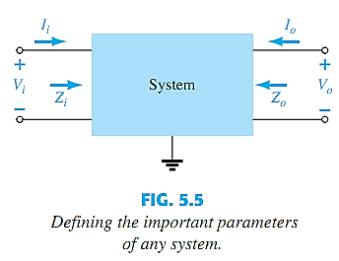
BJT TRANSISTOR MODELING
A model is an equivalent circuit that represents the AC characteristics of the transistor.
A model uses circuit elements that approximate the behavior of the transistor.
There are two models commonly used in small signal AC analysis of a transistor:
r_{e} model
Hybrid equivalent model

Slide 4
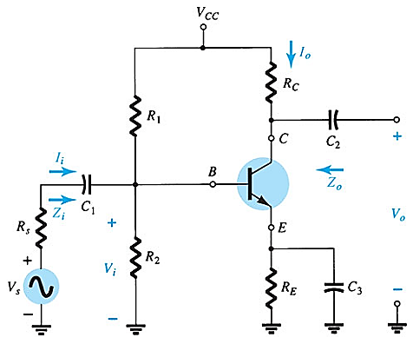
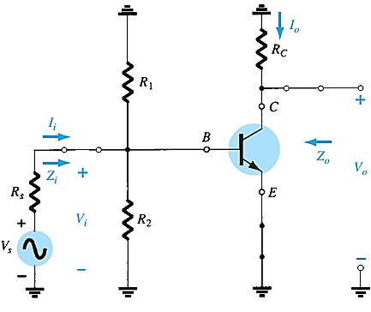
BJT TRANSISTOR MODELING
Capacitors chosen with very small reactance at the frequency of application → replaced by low-resistance or short circuit.
Removal of the dc supply and insertion of the short-circuit equivalent for the capacitors.

Slide 5
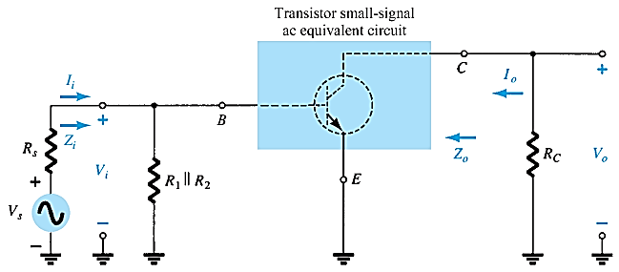
BJT TRANSISTOR MODELING
Circuit redrawn for small signal ac analysis

Slide 6
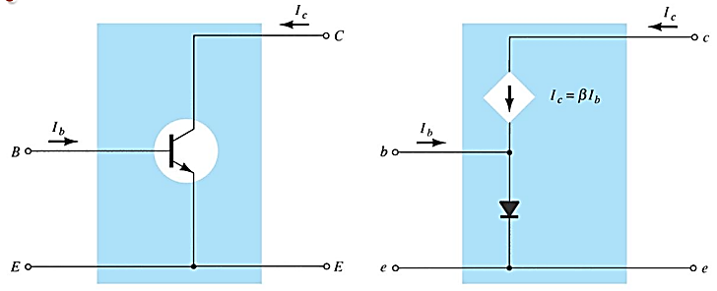
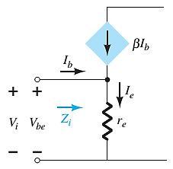
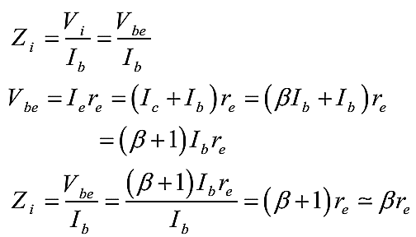
The r_{e} Transistor Model (Common Emitter Configuration)

Slide 7
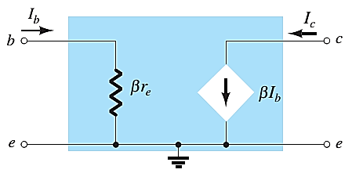

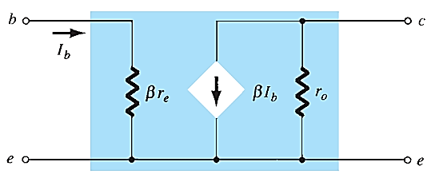
The r_{e} Transistor Model (Common Emitter Configuration)

Slide 8
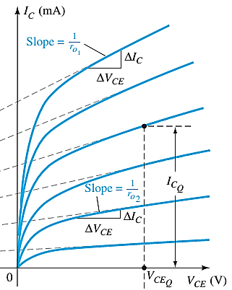


The r_{e} Transistor Model (Common Emitter Configuration)

Slide 9
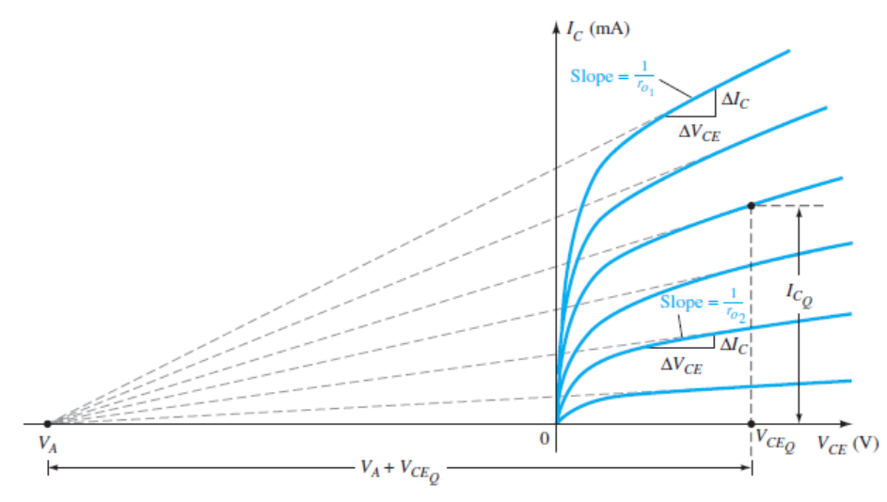
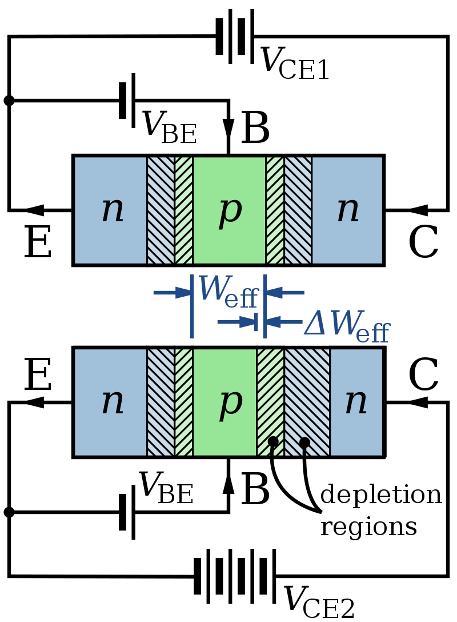
The r_{e} Transistor Model (Common Emitter Configuration)
The Early effect, named after its discoverer James M. Early, is the variation in the effective width of the base in a bipolar junction transistor (BJT) due to a variation in the applied base-to-collector voltage.
A greater reverse bias across the collector–base junction, for example, increases the collector–base depletion width, thereby decreasing the width of the charge carrier portion of the base.

Slide 10
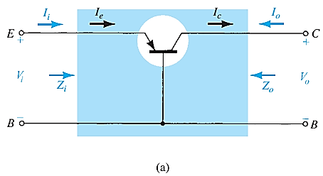
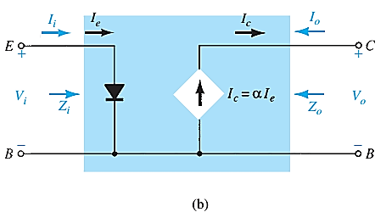
COMMON-BASE CONFIGURATION

Slide 11
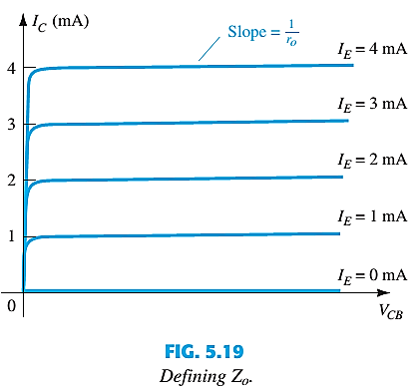
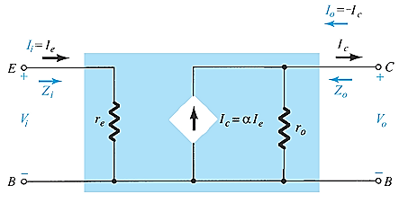
COMMON-BASE CONFIGURATION
The output resistance r₀ is quite high. typically extend into the MΩ range.
Common Base r_{e} equivalent circuit

Slide 12
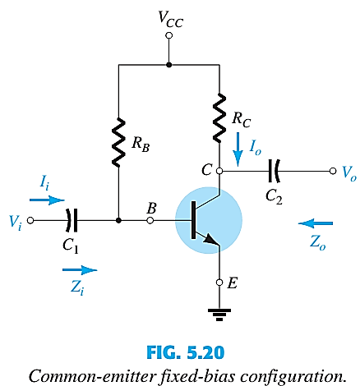
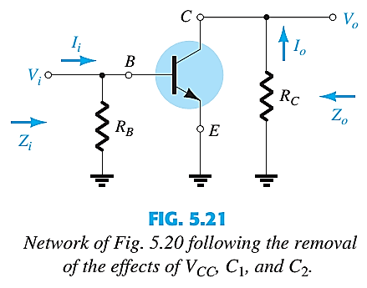
COMMON EMITTER FIXED BIAS CONFIGURATION

Slide 13
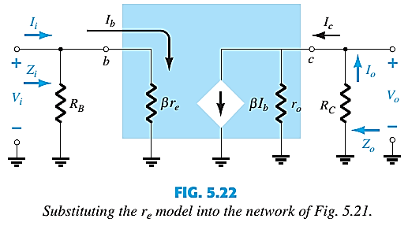
COMMON EMITTER FIXED BIAS CONFIGURATION

Slide 14
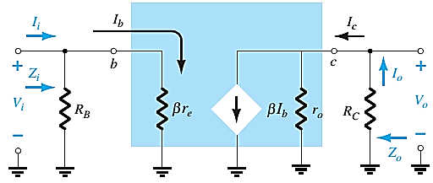







COMMON EMITTER FIXED BIAS CONFIGURATION
INPUT IMPEDANCE, Z_{i}
$Z_{i}= R_{B}‖$ β$r_{e}$
$Z_{i}≅$β$r_{e}$|$R_{B}≥10\text{β}r_{e}$
OUTPUT IMPEDANCE, Z_{o}
VOLTAGE GAIN, A_{v}
$Z_{o}= R_{C}‖$ $r_{o}$
$V_{o}= {−\text{β}I_{b}(R}_{C}‖$ $r_{o})=−\text{β}\text{(}\frac{V_{i}}{\text{β}r_{e}}$)${ (R}_{C}‖$ $r_{o});$
$$I_{b}= \frac{V_{i}}{\text{β}r_{e}}$$
$Z_{o}≅ R_{C}$|$r_{o}≥10R_{C}$
$A_{v}= \frac{V_{o}}{V_{i}}$ = - $\frac{{ (R}_{C}‖ r_{o})}{r_{e}}$, ${ A}_{v}$= - $\frac{{ R}_{C}}{r_{e}} |r_{o}≥10R_{C}$
For the majority of situations R B is greater than b r e by more than a factor of 10

Slide 15
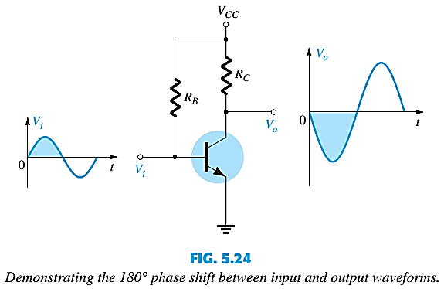
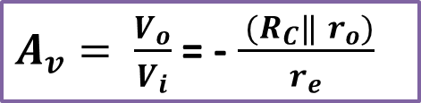
COMMON EMITTER FIXED BIAS PHASE RELATIONSHIP
$A_{v}= \frac{V_{o}}{V_{i}}$ = - $\frac{{ (R}_{C}‖ r_{o})}{r_{e}}$
Demonstrating the 180° phase shift between input and output waveforms.
Why is transistor output inverted?
The inversion is because of the direction of the current source is the reverse of the vbe, so an increase in vbe results in decrease of vce

Slide 16
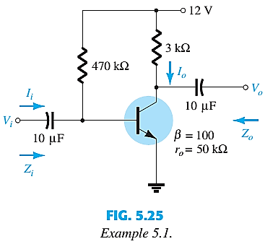
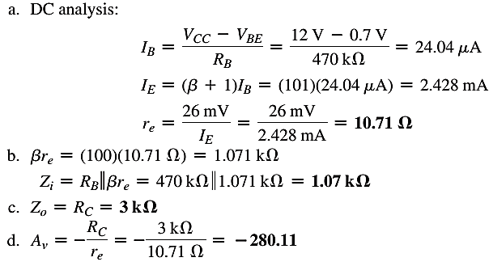

EXAMPLE
EXAMPLE 5.1: For the network of Fig. 5.25 :
Determine r_{e}, Z_{i} (with r_{o} = ∞), Z_{o} (with r_{o} = ∞), A_{v} (with r_{o} = ∞) and Repeat with r_{o} = 50 kΩ.

Slide 17
End of Lecture-1

